Slide 1



ACM SenSys 2020
Symphony: Localizing Multiple Acoustic Sources with a Single
Microphone Array
Weiguo Wang ¹, Jinming Li ¹, Yuan He ¹, Yunhao Liu ^{1,2}
¹ School of Software and BNRist, Tsinghua University
² Department of Computer Science and Engineering, Michigan State University

Slide 2
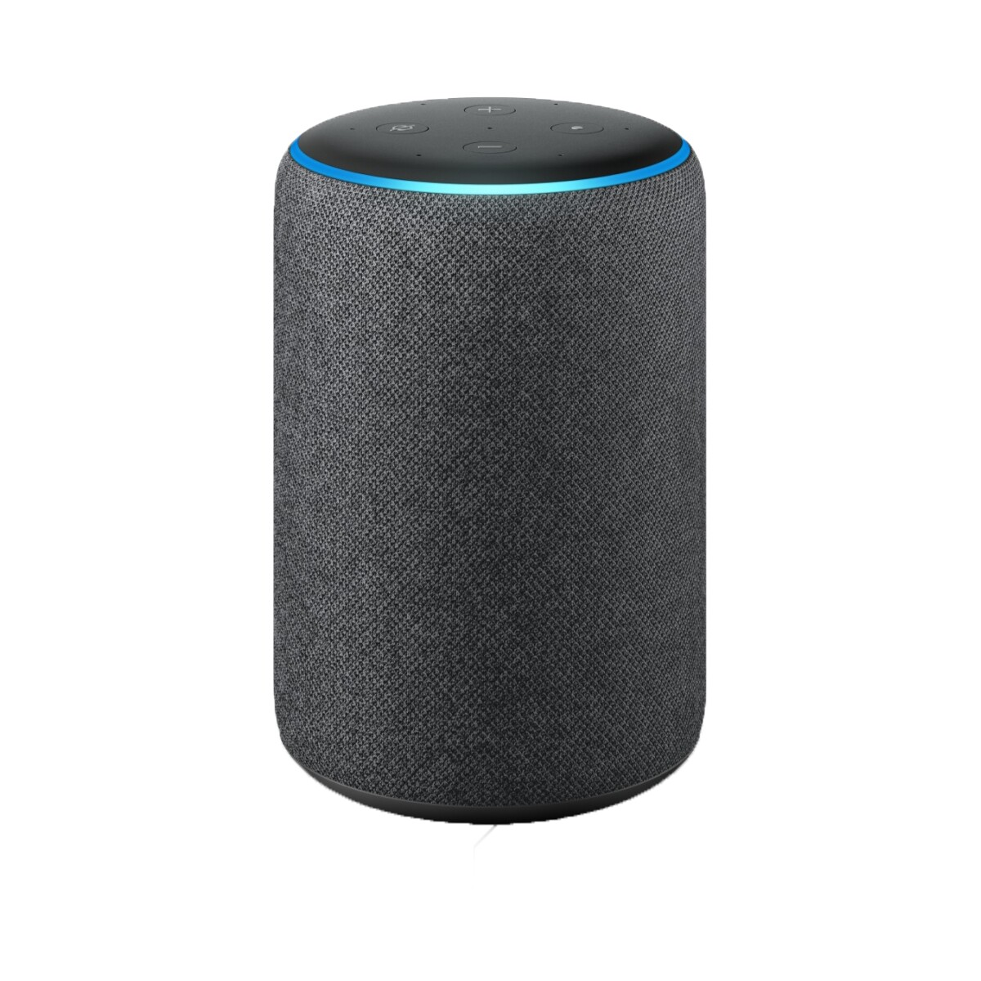
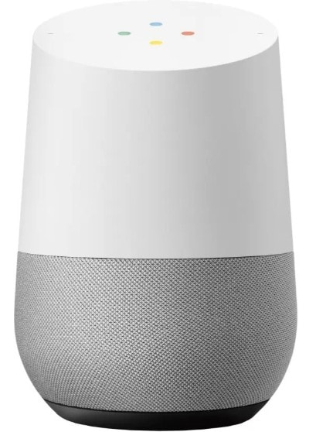

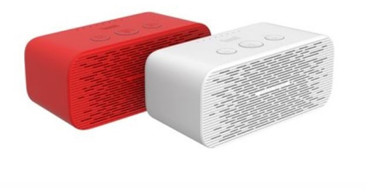
Smart Speakers are Increasingly Popular
Amazon ECHO
Apple HomePod
Google Home
Tmall Genie
Applications
Voice control of home appliances.
Human-machine dialogue.
Entertainment.

Slide 3
Can multiple sources be concurrently localized
with a single device ?
Where are these sources?
Smart Speaker

Slide 4
Why?
Motivation

Slide 5
Locations

Slide 6

Locations

Slide 7


States

Slide 8
Primer #1: Far-Field Effect
Mic. Array
2
Rays
1
Source
0

Slide 9
Primer #1: Far-Field Effect
Mic. Array
2
DoA1
1
DoA2
Source
0
DoA: Direction of Arrival.

Slide 10
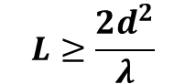
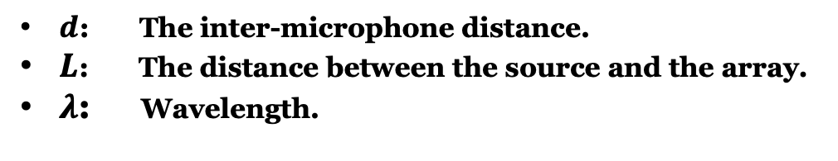



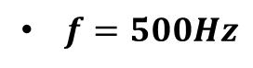
Primer #1: Far-Field Effect
Mic. Array
Parallel Rays
2
A source is considered to be in the far-field, if
1
$$L≥\frac{2d^{2}}{λ}$$
d
Source
0
$d=0.15m$
$L≥6.8cm$
too close to be separated
$f=500Hz$
$λ=0.66m$
L
$d$: The inter-microphone distance.
$L$: The distance between the source and the array.
$λ$: Wavelength.
For the far-field source, the commercial array with limited spatial resolution is difficult to sperate the DoAs of its rays

Slide 11
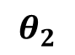
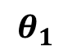
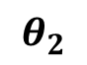
Primer #2: Localization with a single Array
Source
$$θ_{1}$$
$$θ_{2}$$
$$θ_{2}$$
Virtual
Real
Array
Array
Wall
By viewing the nearby wall as a mirror, we can create a virtual array.
Before the arrival of ECHO, there will be a short window of the clean signal.
In practice, due to inter-source interference, it’s unlikely to obtain the clean signal of the target sources

Slide 12
A Multi-Source Localization System
Symphony

Slide 13
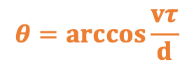

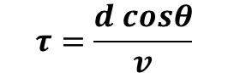
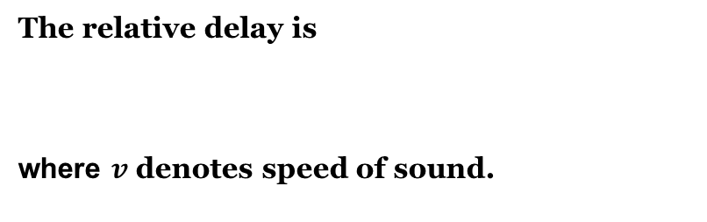
Challenge #1: DoA Estimation
Simple Case: Single Source and Single Path
Cross Correlation
0
$$τ$$
Time Shift
The relative delay is
where $v$ denotes speed of sound.
$$τ=\frac{d cosθ}{v}$$
$$θ=arccos\frac{vτ}{d}$$

Slide 14
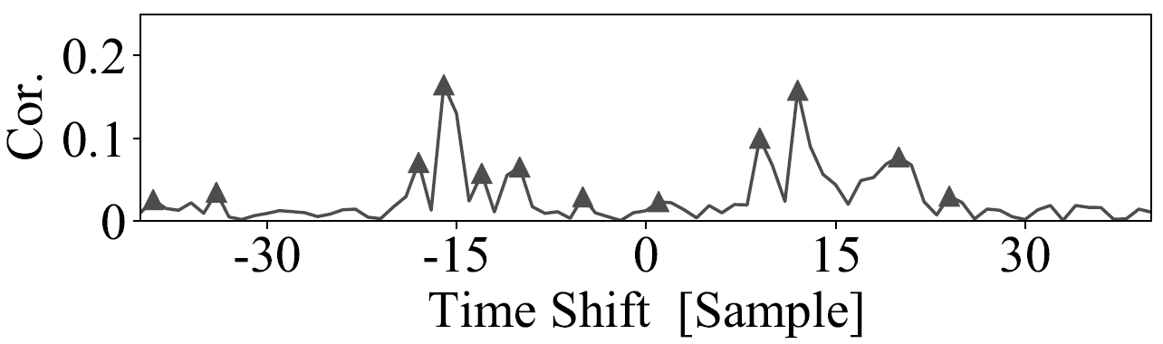
Challenge #1: DoA Estimation
Complex Case: Multipath Sources and Multiple Paths
Which peaks we should choose to calculate DoAs?
Cross Correlation
Multiple sources along multiple directional paths
Multiple Peaks in Cross-Correlation Function

Slide 15
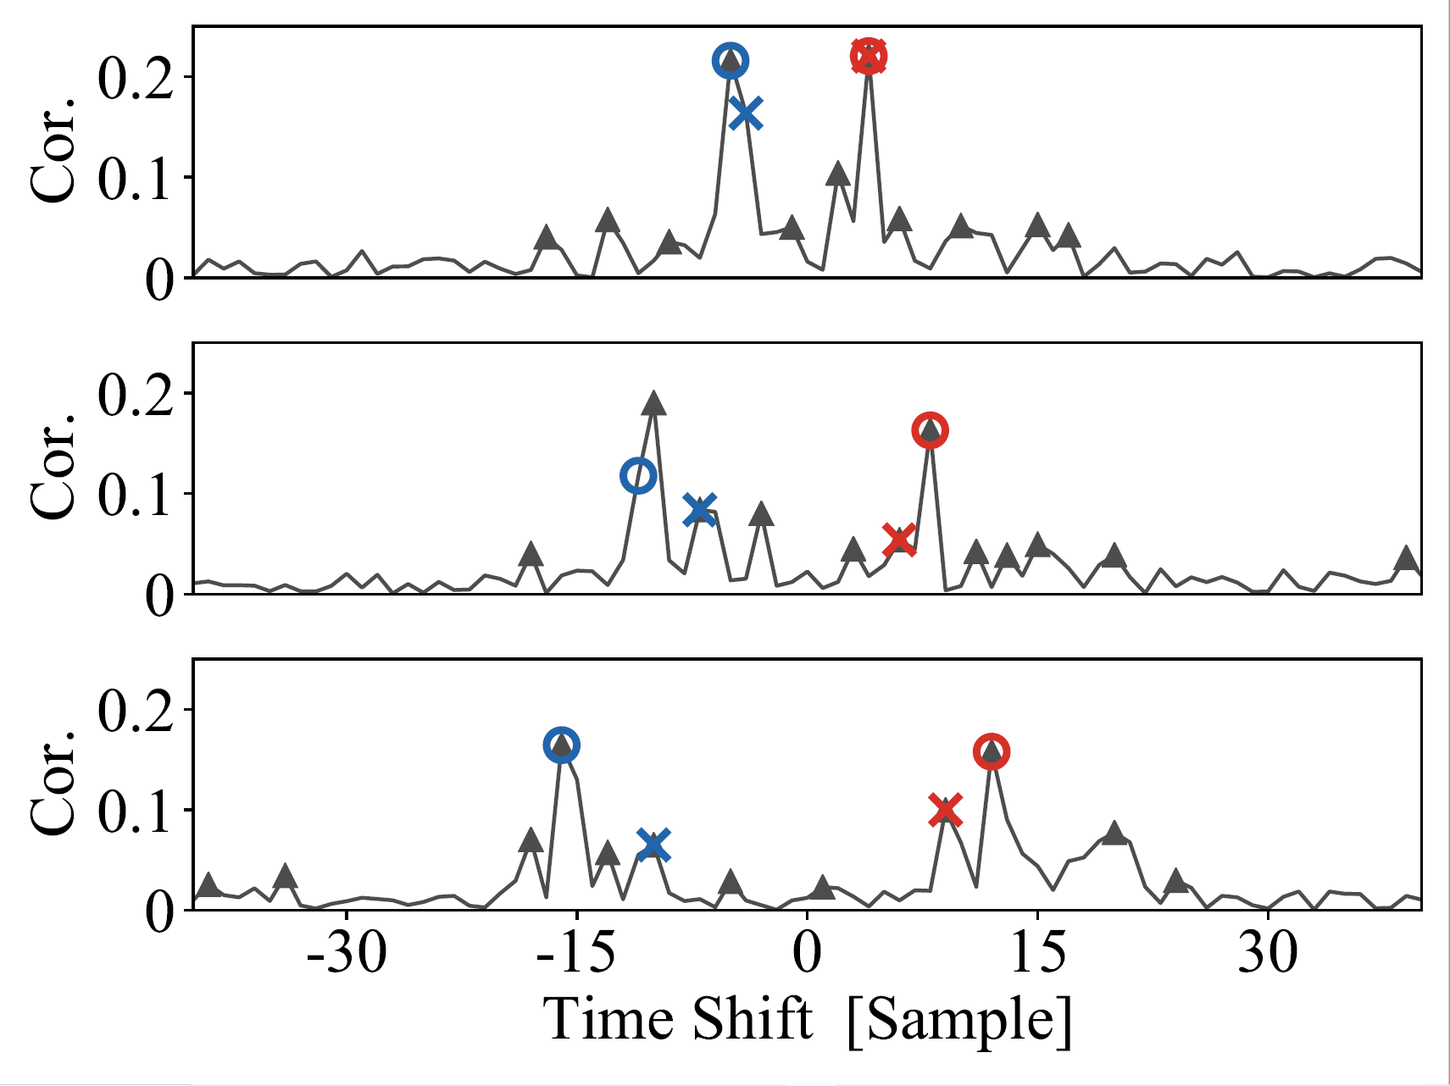
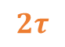
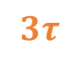

Insight #1: Exploit Geometric Redundancy
The locations of the correlation peaks across different microphone pairs should follow a certain pattern.
Pair <0, 1>
$$τ$$
Pair <0, 2>
$$2τ$$
Pair <0, 3>
Multiple sources along multiple directional paths
$$3τ$$

Slide 16
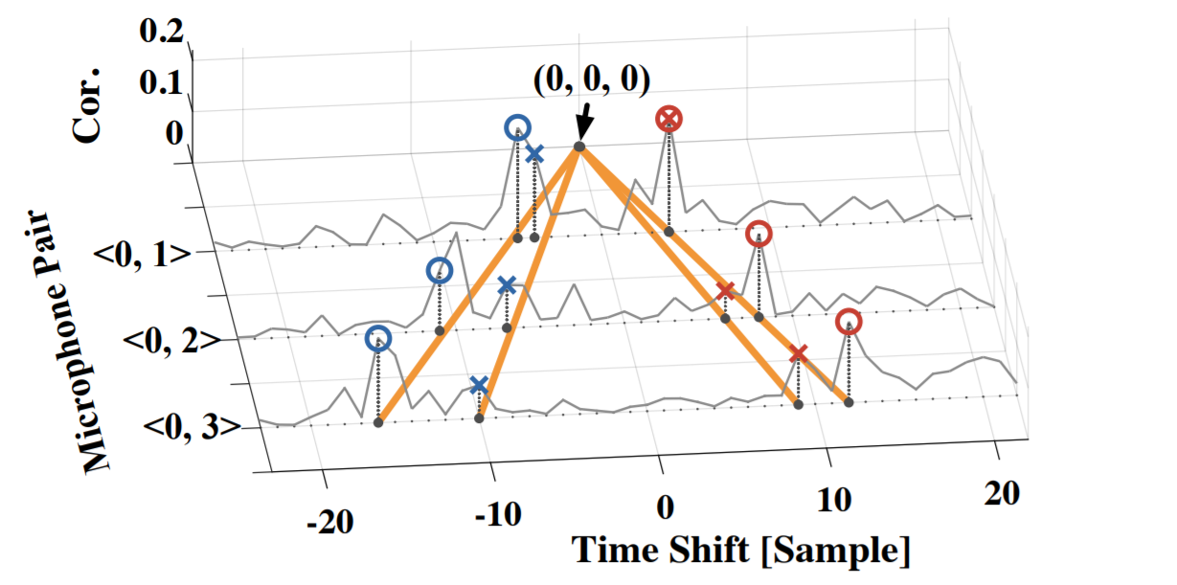



Insight #1: Exploit Geometric Redundancy
$$τ$$
$$2τ$$
$$3τ$$
We exploit such linear relation to choose desired peaks to calculate DoAs.

Slide 17


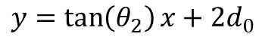

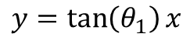

Challenge #2: DoA Recognition
$$θ_{1}$$
$$θ_{2}$$
$$θ_{3}$$
$$θ_{4}$$
Reverse Ray-Tracing
DoAs
estimated
$$y=\tan\left(θ_{1}\right)x$$
(LOS)
$$y=\tan\left(θ_{2}\right)x+2d_{0}$$
(ECHO)

Slide 18


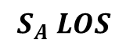



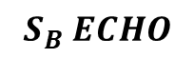
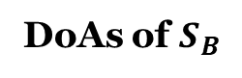
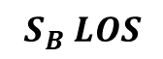

Challenge #2: DoA Recognition
LOS
ECHO
DoAs of $S_{A}$
Step1:
Recognize which two DoAs belongs to the same source.
$$θ_{1}$$
$$θ_{2}$$
$$θ_{3}$$
$$θ_{4}$$
$$θ_{1}$$
$$θ_{2}$$
DoAs of $S_{B}$
Step2:
Recognize which DoA is corresponding to LOS or ECHO.
Reverse Ray-Tracing
$$θ_{3}$$
$$θ_{4}$$
DoAs
estimated
$$S_{A} LOS$$
$$S_{A} ECHO$$
$$y=\tan\left(θ_{1}\right)x$$
(LOS)
$$y=\tan\left(θ_{2}\right)x+2d_{0}$$
(ECHO)
$$S_{B} LOS$$
$$S_{B} ECHO$$

Slide 19

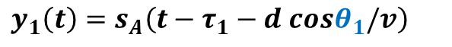

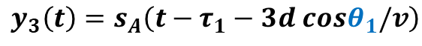


Solution #2: DoA Estimation
Step 1: Homologous Identification of DoA
The ECHO path is a delayed version of the LOS path.
Two paths, coming from the same source, are coherent.
$$y_{0}\left(t\right)=s_{A}\left(t−τ_{1}\right)$$
+ $s_{A}\left(t−τ_{2}\right)$
+ …
$$y_{1}\left(t\right)=s_{A}\left(t−τ_{1}−d cosθ_{1}/v\right)$$
+ $s_{A}\left(t−τ_{2}−d cosθ_{2}/v\right)$
+ …
$$y_{2}\left(t\right)=s_{A}\left(t−τ_{1}−2d cosθ_{1}/v\right)$$
+ $s_{A}\left(t−τ_{2}−2d cosθ_{2}/v\right)$
+ …
$$y_{3}\left(t\right)=s_{A}\left(t−τ_{1}−3d cosθ_{1}/v\right)$$
+${ s}_{A}\left(t−τ_{2}−3d cosθ_{2}/v\right)$
+ …
LOS
ECHO

Slide 20


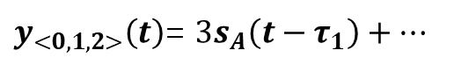
Solution #2: DoA Estimation
Step 1: Homologous Identification of DoA
ECHO is a delayed version of the LOS path.
Two paths, coming from the same source, are coherent
Compensate
Delay w.r.t. $θ_{1}$
$$∑$$
$y_{<0,1,2>}\left(t\right)$= $3s_{A}\left(t−τ_{1}\right)+…$
Constructive
Combine
Enhanced LOS
$$y_{0}\left(t\right)=s_{A}\left(t−τ_{1}\right)$$
+ $s_{A}\left(t−τ_{2}\right)$
+ …
$$y_{1}\left(t\right)=s_{A}\left(t−τ_{1}−d cosθ_{1}/v\right)$$
+ $s_{A}\left(t−τ_{2}−d cosθ_{2}/v\right)$
+ …
$$y_{2}\left(t\right)=s_{A}\left(t−τ_{1}−2d cosθ_{1}/v\right)$$
+ $s_{A}\left(t−τ_{2}−2d cosθ_{2}/v\right)$
+ …
$$y_{3}\left(t\right)=s_{A}\left(t−τ_{1}−3d cosθ_{1}/v\right)$$
+${ s}_{A}\left(t−τ_{2}−3d cosθ_{2}/v\right)$
+ …
LOS
ECHO

Slide 21
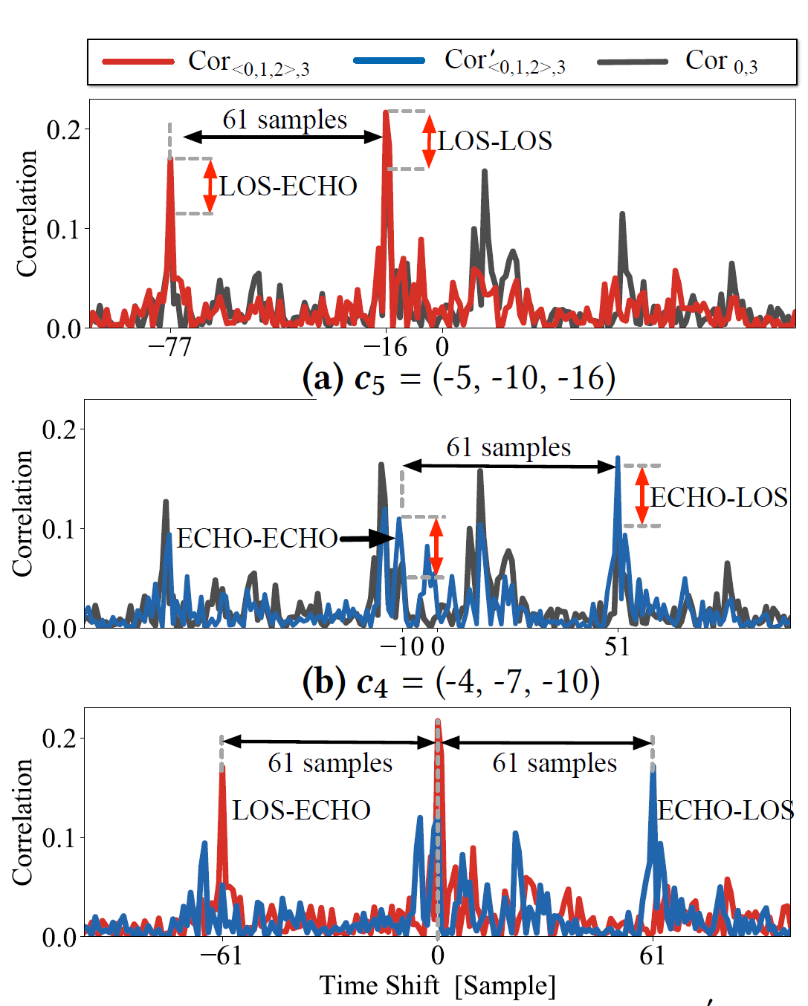
Solution #2: DoA Estimation
Step 1: Homologous Identification of DoA
ECHO is a delayed version of the LOS path.
Two paths, coming from the same source, are coherent
Compensate
Delay w.r.t. $θ_{1}$
$$∑$$
$y_{<0,1,2>}\left(t\right)$= $3s_{A}\left(t−τ_{1}\right)+…$
Constructive
Combine
Enhanced LOS
$$y_{0}\left(t\right)=s_{A}\left(t−τ_{1}\right)$$
+ $s_{A}\left(t−τ_{2}\right)$
+ …
LOS-LOS
LOS-ECHO
$$y_{1}\left(t\right)=s_{A}\left(t−τ_{1}−d cosθ_{1}/v\right)$$
+ $s_{A}\left(t−τ_{2}−d cosθ_{2}/v\right)$
+ …
$$y_{2}\left(t\right)=s_{A}\left(t−τ_{1}−2d cosθ_{1}/v\right)$$
+ $s_{A}\left(t−τ_{2}−2d cosθ_{2}/v\right)$
+ …
$$y_{3}\left(t\right)=s_{A}\left(t−τ_{1}−3d cosθ_{1}/v\right)$$
+${ s}_{A}\left(t−τ_{2}−3d cosθ_{2}/v\right)$
+ …
LOS
ECHO

Slide 22
Solution #2: DoA Estimation
Step 1: Homologous Identification of DoA
ECHO is a delayed version of the LOS path.
Two paths, coming from the same source, are coherent
Compensate
Delay w.r.t. $θ_{1}$
$$∑$$
$y_{<0,1,2>}\left(t\right)$= $3s_{A}\left(t−τ_{1}\right)+…$
Constructive
Combine
Enhanced LOS
$$y_{0}\left(t\right)=s_{A}\left(t−τ_{1}\right)$$
+ $s_{A}\left(t−τ_{2}\right)$
+ …
LOS-LOS
LOS-ECHO
$$y_{1}\left(t\right)=s_{A}\left(t−τ_{1}−d cosθ_{1}/v\right)$$
+ $s_{A}\left(t−τ_{2}−d cosθ_{2}/v\right)$
+ …
$$y_{2}\left(t\right)=s_{A}\left(t−τ_{1}−2d cosθ_{1}/v\right)$$
+ $s_{A}\left(t−τ_{2}−2d cosθ_{2}/v\right)$
+ …
$$y_{3}\left(t\right)=s_{A}\left(t−τ_{1}−3d cosθ_{1}/v\right)$$
+${ s}_{A}\left(t−τ_{2}−3d cosθ_{2}/v\right)$
+ …
LOS
ECHO

Slide 23
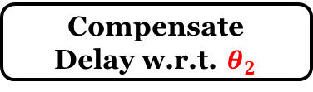
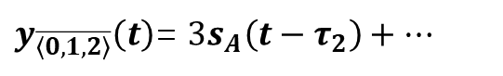
Solution #2: DoA Estimation
Step 1: Homologous Identification of DoA
ECHO is a delayed version of the LOS path.
Two paths, coming from the same source, are coherent
Compensate
Delay w.r.t. $θ_{2}$
$$∑$$
$y_{\overline{\left\langle 0,1,2\right\rangle }}\left(t\right)$= $3s_{A}\left(t−τ_{2}\right)+…$
Constructive
Combine
Enhanced ECHO
$$y_{0}\left(t\right)=s_{A}\left(t−τ_{1}\right)$$
+ $s_{A}\left(t−τ_{2}\right)$
+ …
$$y_{1}\left(t\right)=s_{A}\left(t−τ_{1}−d cosθ_{1}/v\right)$$
+ $s_{A}\left(t−τ_{2}−d cosθ_{2}/v\right)$
+ …
$$y_{2}\left(t\right)=s_{A}\left(t−τ_{1}−2d cosθ_{1}/v\right)$$
+ $s_{A}\left(t−τ_{2}−2d cosθ_{2}/v\right)$
+ …
$$y_{3}\left(t\right)=s_{A}\left(t−τ_{1}−3d cosθ_{1}/v\right)$$
+${ s}_{A}\left(t−τ_{2}−3d cosθ_{2}/v\right)$
+ …
LOS
ECHO

Slide 24
Solution #2: DoA Estimation
Step 1: Homologous Identification of DoA
ECHO is a delayed version of the LOS path.
Two paths, coming from the same source, are coherent
Compensate
Delay w.r.t. $θ_{2}$
$$∑$$
$y_{\overline{\left\langle 0,1,2\right\rangle }}\left(t\right)$= $3s_{A}\left(t−τ_{2}\right)+…$
Constructive
Combine
Enhanced ECHO
$$y_{0}\left(t\right)=s_{A}\left(t−τ_{1}\right)$$
+ $s_{A}\left(t−τ_{2}\right)$
+ …
ECHO-LOS
ECHO-ECHO
$$y_{1}\left(t\right)=s_{A}\left(t−τ_{1}−d cosθ_{1}/v\right)$$
+ $s_{A}\left(t−τ_{2}−d cosθ_{2}/v\right)$
+ …
$$y_{2}\left(t\right)=s_{A}\left(t−τ_{1}−2d cosθ_{1}/v\right)$$
+ $s_{A}\left(t−τ_{2}−2d cosθ_{2}/v\right)$
+ …
$$y_{3}\left(t\right)=s_{A}\left(t−τ_{1}−3d cosθ_{1}/v\right)$$
+${ s}_{A}\left(t−τ_{2}−3d cosθ_{2}/v\right)$
+ …
LOS
ECHO

Slide 25
Solution #2: DoA Estimation
Step 1: Homologous Identification of DoA
ECHO is a delayed version of the LOS path.
Two paths, coming from the same source, are coherent
Compensate
Delay w.r.t. $θ_{2}$
$$∑$$
$y_{\overline{\left\langle 0,1,2\right\rangle }}\left(t\right)$= $3s_{A}\left(t−τ_{2}\right)+…$
Constructive
Combine
Enhanced ECHO
$$y_{0}\left(t\right)=s_{A}\left(t−τ_{1}\right)$$
+ $s_{A}\left(t−τ_{2}\right)$
+ …
ECHO-LOS
ECHO-ECHO
$$y_{1}\left(t\right)=s_{A}\left(t−τ_{1}−d cosθ_{1}/v\right)$$
+ $s_{A}\left(t−τ_{2}−d cosθ_{2}/v\right)$
+ …
$$y_{2}\left(t\right)=s_{A}\left(t−τ_{1}−2d cosθ_{1}/v\right)$$
+ $s_{A}\left(t−τ_{2}−2d cosθ_{2}/v\right)$
+ …
$$y_{3}\left(t\right)=s_{A}\left(t−τ_{1}−3d cosθ_{1}/v\right)$$
+${ s}_{A}\left(t−τ_{2}−3d cosθ_{2}/v\right)$
+ …
LOS
ECHO

Slide 26
Solution #2: DoA Estimation
Step 1: Homologous Identification of DoA
Enhanced Correlation Function w.r.t. $θ_{1}$
Enhanced Correlation Function w.r.t. $θ_{2}$

Slide 27
Solution #2: DoA Estimation
Step 2: Discrimination between LOS and ECHO
Reverse Ray-Tracing
To ensure that LOS can intersect with ECHO ,
the absolute value of the slope of LOS should be smaller than that of ECHO.
i. e.， | tan θ1 | < | tan θ2 |.

Slide 28
Implementation
Key Settings：
Inter-mic. Distance: 5cm
Sampling frequency： 48KHz
Speed of sound：343m/s

Slide 29
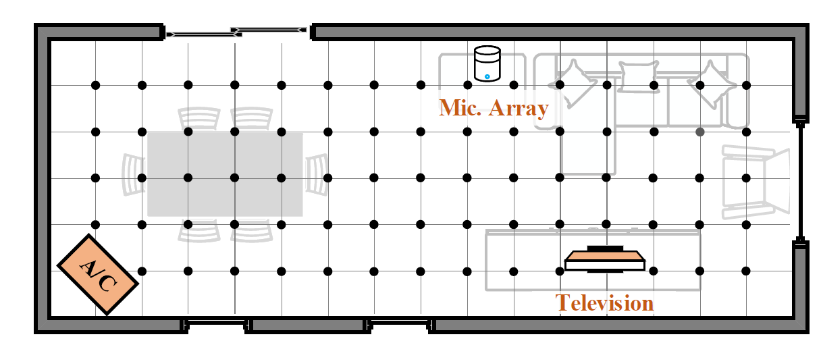
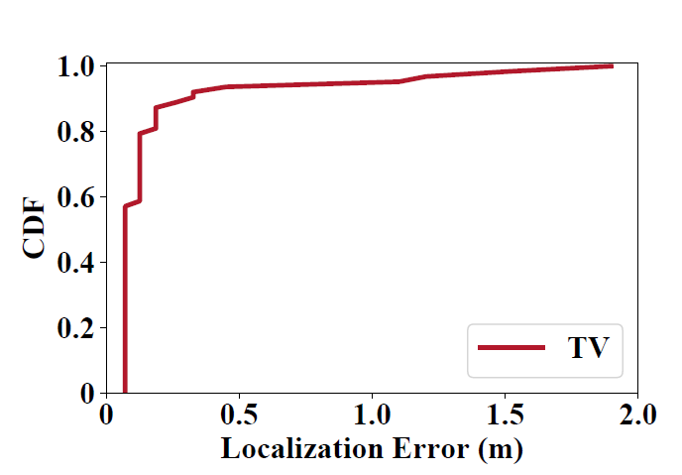
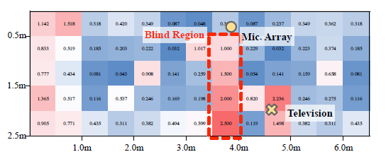
Evaluation
Localization in the Multi-Source Scenario
(a) Living room (8m x 3m)
(c) The localization error of the television.
(b) Heatmap of the localization error

Slide 30
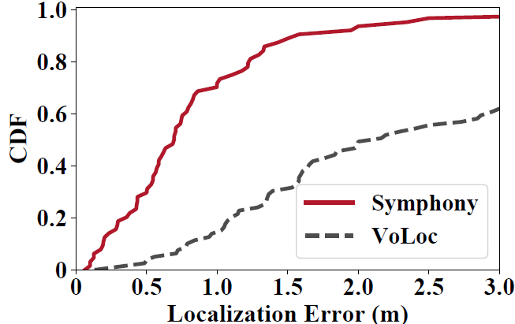
Evaluation
Localization in the Multi-Source Scenario
CDF of the localization error.
(Symphony v.s. VoLoc)

Slide 31
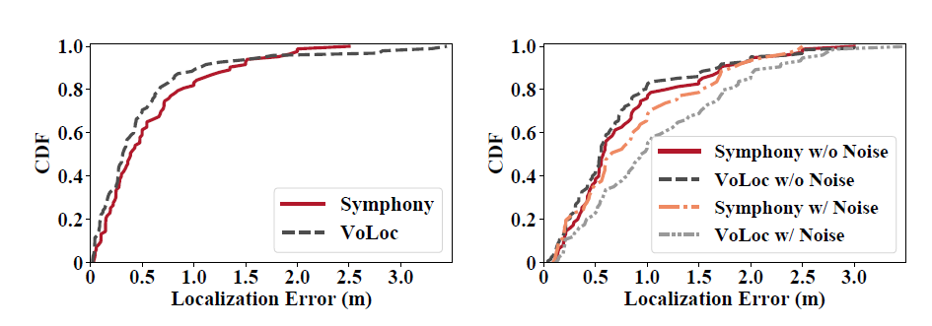
Evaluation
Localization in the Single-Source Scenario
On Quiet Conditions
With or Without Noise
CDF of localization error
(4-mic)
(b) CDF of localization error
(6-mic)

Slide 32
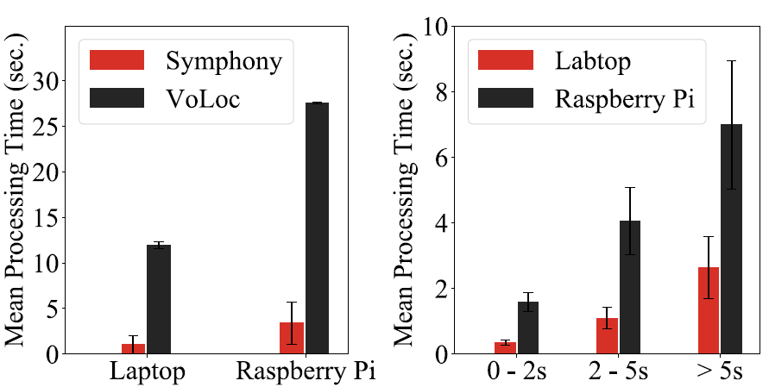
Evaluation
Processing time
Comparison on processing time
processing time across different voice durations.
Symphony is 9x and 8x faster than the baseline on the laptop and the raspberry Pi, respectively

Slide 33
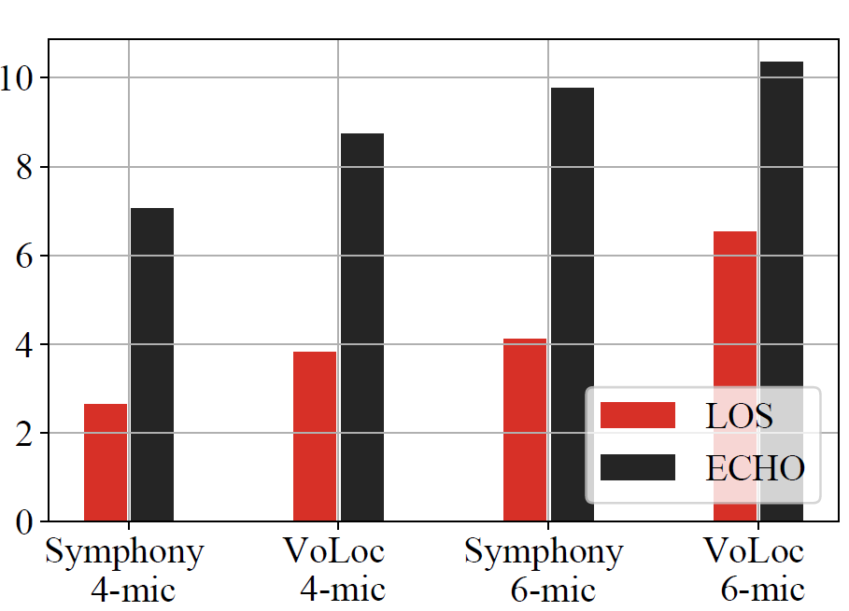
Evaluation
DoA estimation error
With Ambient Noise
DoA estimation error of Symphony and the baseline using 4-mic array and 6-mic array

Slide 34
Related Work
Localization by Exploiting Room Information:
VoLoc: Nearby wall reflection.
Works based on RSSI, CSI, electromagnetic, and visible light.
Localization with Multiple Array:
ArrayTrack: WiFi clients.
RF-Idraw: RFID tags.
Living IoT: Bumblebees
Concurrent Localization:
Chorus and SnapLoc: GPS-Like UWB localization
LF-Backscatter, BiGroup, FlipTracer, HUBBLE, and Fireworks: Concurrent Sensing or Communication.

Slide 35
Conclusion and Future Work
Conclusion:
We exploit the geometric information of the array to concurrently localize multiple sources with a single array.
We hope that Symphony could give birth to many interesting applications for smart speaker, such as multi-person interaction, house safeguard, and robust voice localization
Future Works:
3D Localization.
NLOS Localization.
Moving Objects.

Slide 36



